Slide 1
Choosing The Right College

Slide 2

Imagine colleges as ice cream
What’s your favorite flavor?
What’s your 2nd favorite?
What flavor would you eat last?
Top choice schools
Reasonable Chance Schools
Safety Schools

Slide 3

Rank your priorities and ask for advice
Make a list of factors:
Athletic programs
Hosing options
Class sizes (Teacher – Student Ratio)
Location (close or far from home)
Camus atmosphere
Available majors and classes
Ask everyone for recommendations for certain colleges

Slide 4

Focus on ACADEMIC GOALS
Consider what you want out of an education
Where do you want to be in 4 years?
How does the college rank in the major you want to study?
How many students are studying that major?
How many courses are offered in that field and how many faculty members teach classes associated with that major
Major in a narrow field might consider a larger university
http://colleges.usnews.rankingsandreviews.com/best-colleges

Slide 5

Don’t forget to have a social life
Do you want to pledge (be part of a Geek society?)
What do students do on the weekend?
What extracurricular activities are offered?
How close are you to a major city? (Cultural and Entertainment value)
Do they have service clubs or ROTC opportunities?
BE HAPPY!! ☺

Slide 6

Where will you be living for 4 years
Do most students live on campus or commute?
Do students spend most of their time on campus?
Can you live with strangers?
Would you have roommates if you lived on campus?
How modern or ancient are the dorms?
Does each room have its own bathroom or do you use a shared facility?

Slide 7
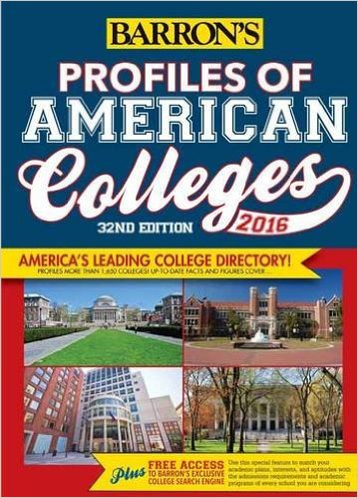
Best place to find answers to your questions?
College directory or websites
Find information about student population, activities, majors offered, costs and financial aid
To get personality of the college
Talk to current students, alumni, recruiters, advisors

Slide 8

Attend a college fair or talk to the college rep
Don’t rely on websites, stats, catalogues or brochures
Talk to real people like a college representative
Take a list of questions with you from your pros or cons list

Slide 9

Beware of the college brochure
Brochures are biased!!
See the pictures of the students studying under the trees in the warm sunshine? That was taken in the early fall before the snow blanketed the campus for next four months.
But used them as a starting point to ask college representatives questions

Slide 10
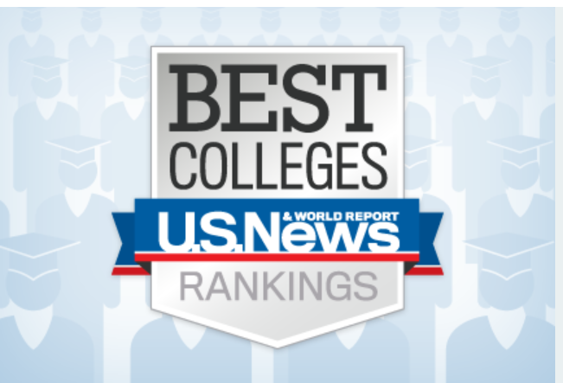
Don’t rely on news magazine ratings
Use rankings as a guide to reputation but do your own research and have a concrete reason for applying
Start with a folder for each college or notebook with dividers
Separate information you gather for each school and put rankings information in its place, next to brochures and notes you took

Slide 11

Compare aid awards
Understand what is free money (scholarships and grants) and what you will have to pay back (loans)

Slide 12
Mistakes to Avoid
Rushing the process
Being a follower
The legacy lure
Rebellion
You’re a die-hard fan
The temptation to party
How a student body looks
Location, location, location
Cost obsessions or carelessness
Not visiting
Relying on reputation
Pushy parents
Having a one track mind
The college specializes in your current major

Slide 13
Do you know your colleges?
What schools had the highest average freshman retention rate?
Columbia
University of Chicago
Yale University

Slide 14
Do you know your colleges?
What are the top 5 party schools?
University of Illinois at Urbana-Champaign
University of Iowa
University of Wisconsin-Madison
Bucknell University
Syracuse University

Slide 15
Do you know your colleges?
Top 5 for entrepreneurship?
Babson College
Brigham Young University
University of Houston
Baylor University
Northeastern University

Slide 16
Do you know your colleges?
Name 1 tuition free school
Berea College
College of the Ozarks
United States Air Force
United States Coast Guard
United States Merchant Marine Academy
United States Military Academy
Webb Institute
United States Naval Academy

Slide 17
Do you know your colleges?
Name top 5 luxurious dorms
The University of Arizona
University of North Florida
University of Texas, Austin
The University of Florida
University of Houston
http://www.fastweb.com/student-life/articles/the-ten-most-luxurious-dorms-in-the-us

Slide 18
Did you know?
Being a Star Trek fan can get you a $500 college scholarship from an organization called Starflee
A condom ambulance service will deliver condoms to your dorm door at the College of New Jersey for a small fee.
California is spending more on prisoners than colleges according to the data presented in 2011.
Nearly 60% of American college students are female; every state but Utah has more women than men in college

